Slide 1

SEARCH ENGINE Optimization(SEO) FOR GOOGLE

Slide 2
Contents
What is SEO?
SEO process.
Popular Search Engines
Search Engine Market shares
How a search Engine works?
Search Engine Optimization For Google
Factors Influencing Rankings
Ranking of websites by Google
Factors Effecting SEO rankings
What is an Algorithm?
Pay per click vs Organic search
Pay per click

Slide 3

What is SEO?
SEO- Search engine optimization
This is a process which concerns on both the on-page and off page rankings factors in order in obtain high search engine rankings for the related terms in the search.
SEO provides a easiest way for a user in finding an webpage or website in a search process. If any user searches for a particular document search engine shows some related topics in a page in order of highly ranked first.
Basically search engines began in the mid 1990’s were users made their search by providing URL or address of that page to find a page in web.
Google, yahoo, Bing are some of the most popular search engines these days by an user.

Slide 4
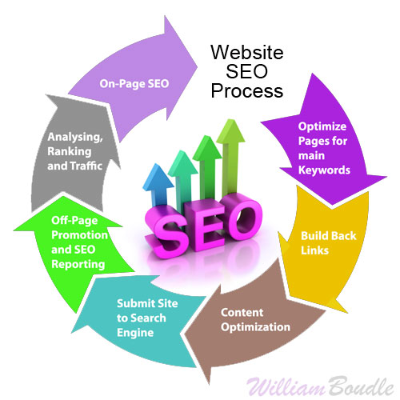
SEO Process
This is a pictorial representation of an optimization process in a search engine.

Slide 5

Popular search engines

Slide 6
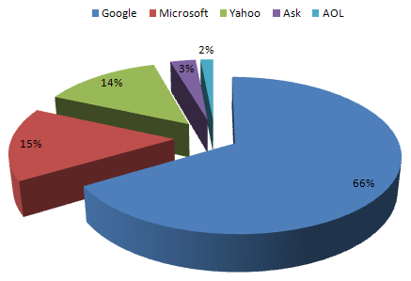
search engine market share
This pie-chart represents that Google has dominated other search engines. Now-a-days a lot of users uses Google search engine as their primary engines to their search, when compared to others.

Slide 7
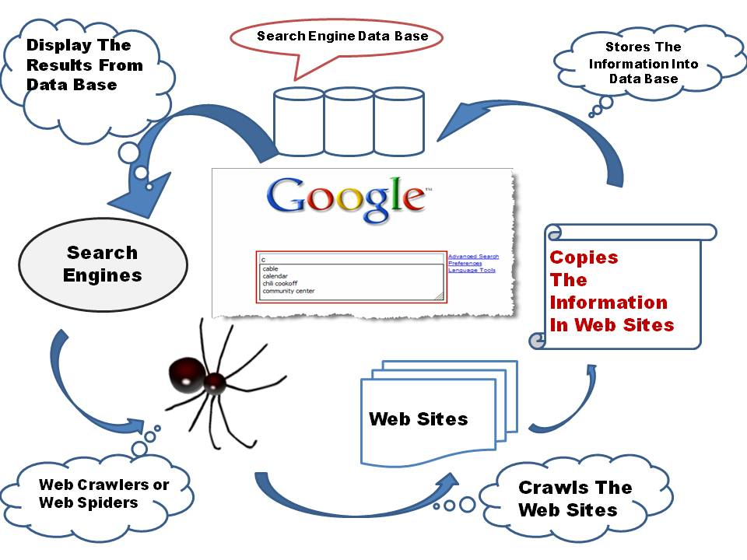
How a search engine works?
Spider crawls web sites in search of new files or web pages, they normally use the hyperlinks in their database to follow them.
Now, search engine prepares an preface in those documents in addition to their databases and it frequently upgrades the contents.
At first Search engine searches the user query in their own database and then it moves to other to search them.
Normally the search engines ranks a document using their algorithms by providing various weightages and ranking factors.

Slide 8
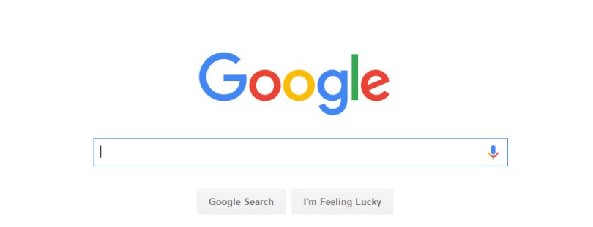
Search Engine optimization for Google: -
INTRODUCTION: -
Google is most user friendly search engine proved for all the users which it give user oriented results .In addition, most of other search engines use Google search patterns so we have concentrated on it. If a page is optimized in Google it is optimized for most of the search engines.
Users use search engines for most of their queries but they only prefer the results available on first page and 2-3% of users go on further pages (except Researchers), Now imagine if the page of an organization is on 2-3rd or 4th page then the business which can be generated from that page has a very less change to return and user will prefer the page coming on the 1st page.

Slide 9
Factors influencing rankings
On-page factors
OFF-page factors
Title tags<title>
Header tags<h1>
Image tags
Content(Body text)<body>
Hyperlink text
Keyword frequency& density
Anchor text
Link Popularity – adds credibility to your site
Social media
Site map

Slide 10
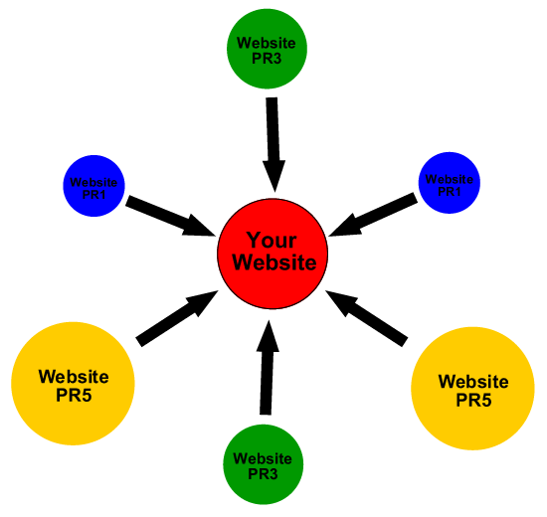
Ranking of Website by Google
Basically a website is ranked by Google by using following key factors,
- Keyword usage.
- Site structure
- Site speed
- Time spent on site.
- Number of inbound links
- Quality of inbound links
A website gets importance ,when Google ranks to it.

Slide 11
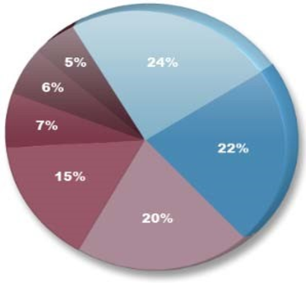
Factors effecting SEO Ranking
24% Trust/Authority of the Host Domain
22% Link Popularity of the Specific Page
20% Anchor Text of External Links to the Page
15% On-Page Keyword Usage
7% Visitor/Traffic & Click-Through Data
6% Social Graph Metrics
5% Registration & Hosting Data

Slide 12
WHAT IS AN ALGORITHM?
An algorithm is used by Google which assigns numerical weight to the URL of web documents to measure its relevance.
Algorithm of the search engine is highly secured, only the selected employees of the actual search engines knows that.
By research and experiments, reverse engineering provides SEOs a good idea of major factors and approximate weight assignments.
Google make frequently changes, tweaks, updates to its algorithm, so that it can be secured.
They not only changes algorithm but also changes websites and documents being searched are also constantly changes.
Basically algorithm varies by different Search Engines – some give more weight to on-page factors, and few are to link popularity.

Slide 13
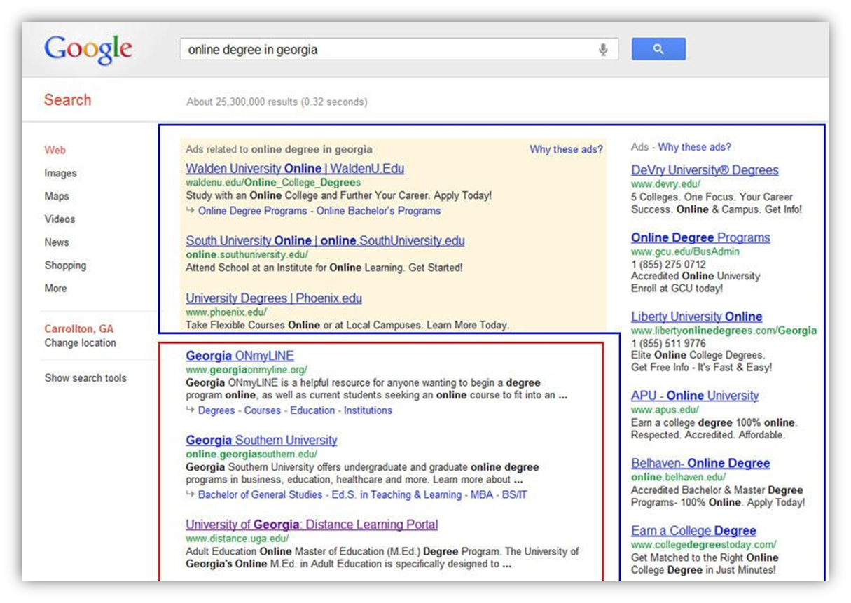
pay per click vs Organic search
Sponsored links
Organic search

Slide 14
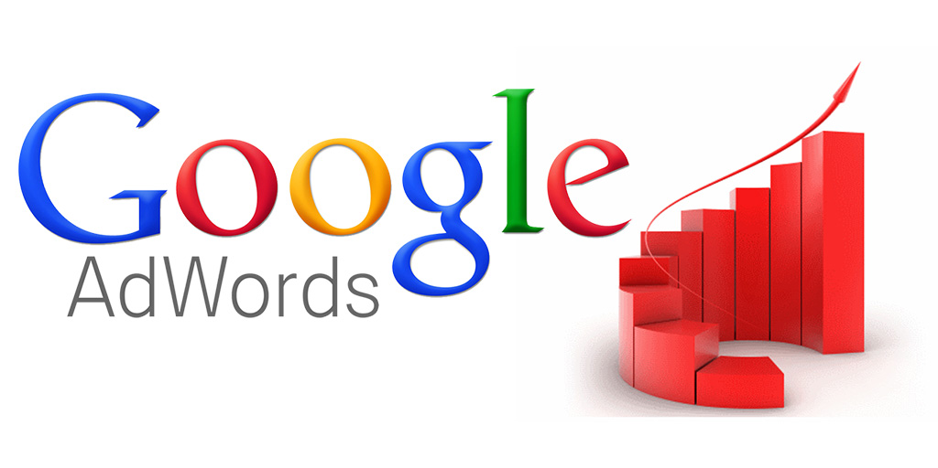

Pay per click
Normally pay per click appears as “sponsored listings”
Many companies will bid an price they are willing to pay “per click”
They have a ability to control the ad text
They have an ability to set their own budgets and spending limits.
Those links contains a very good tracking tools and statistics with them.
Google AdWords and overture are the two leaders of such pay per clicks links.

Slide 15
Interaction of users with search engines
Search process: -
If a user need for an answer, solution or piece of information.
Make the need in a string of words or phrases.
Enter the words in the search engine and execute that.
Make a survey of the results for a match that you looking for.
select a result.
Verify the content of the webpage or a link to that solution.
If the result you got is matched that you looking for then browse for another link or…
Perform a new search by making changes to the query.

Slide 16
Advantages & disadvantages of seo
ADV: -
This gives a continuous flow of free and proposed traffic.
SEO help’s a user’s in his business growth.
It is cost-effective. A user don’t have to pay a search engine to be advertised
DIS-ADV: -
SEO doesn’t give a user its full control to access it.
This is a time consuming process. It might takes months, sometimes years wait to get into spotlight.
The position of user’s page cannot be predicted.

Slide 17
Tips & Optimization techniques
Firstly ensure that your text is in HTML and not in image text.
A complete research on keywords which is related to your business.
Make the descriptive title tags for each page.
Make sure to use text links if possible.
Regularly monitor your search engine rankings and more importantly your website traffic statistics and sales/leads produced.
Should know well about search engine marketing or consult a search engine optimization firm or SEO expert.

Slide 18
References
Vinit Kumar, Gunjan. Search Engine Optimization with Google 3rd ser. 9.1 (2012): n. pag. Web.
Vivekananda, Khanna Samrat, O. CONCEPT OF SEARCH ENGINE OPTIMIZATION IN WEB SEARCH ENGINE. 1st ed. Vol. 1. N.p.: n.p., n.d. International Journal of Advanced Engineering Research and Studies. Web.
Lei, Huang. "Journal of Marketing Development and Competitiveness." Social Media in an Alternative Marketing Communication Model 1st ser. 6 (2012): n. pag. Web.
Tom, Seymour. "International Journal of Management & Information Systems." History of Search Engines 4th ser. 15 (2011): n. pag. Web.

Slide 19
THANK YOU

